Slide 1
European Roulette Wheel
Paul Vu, Caroline Floom
Jeffrey Maldonado

Slide 2
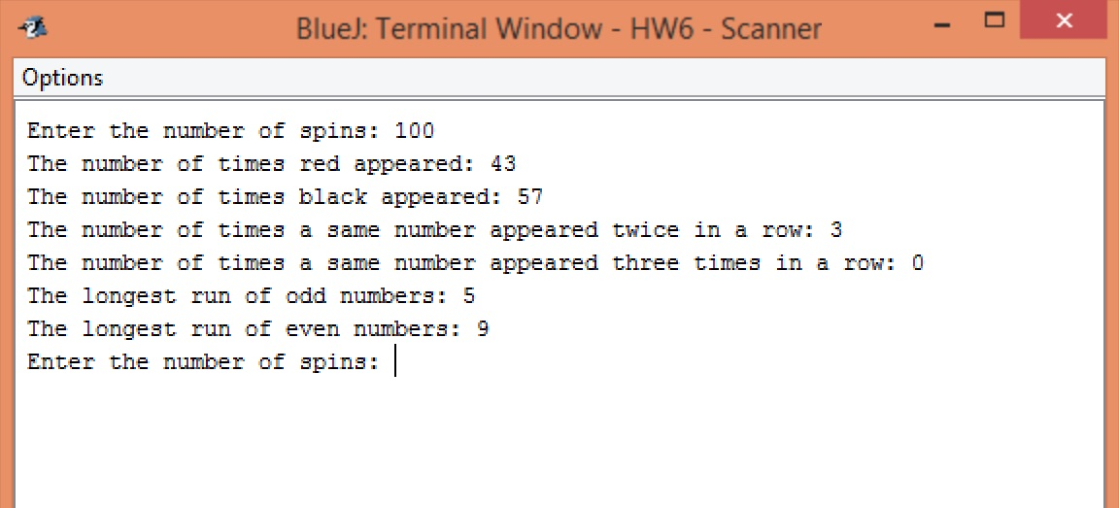
Trial One (100 Spins)

Slide 3
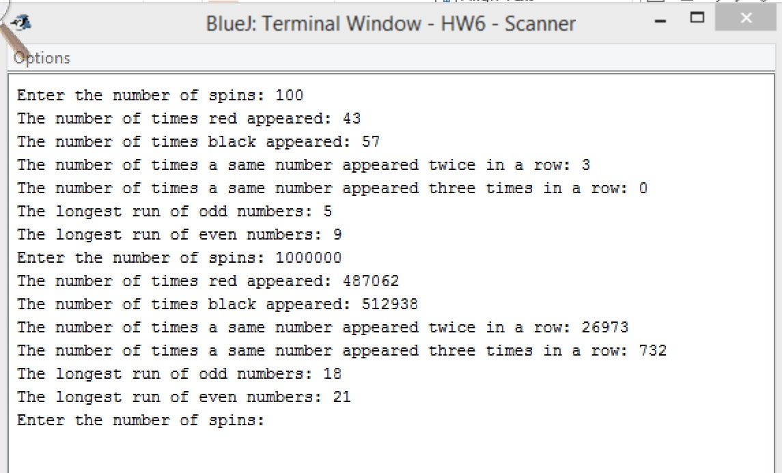
Trial Two (1,000,000 Spins)

Slide 4
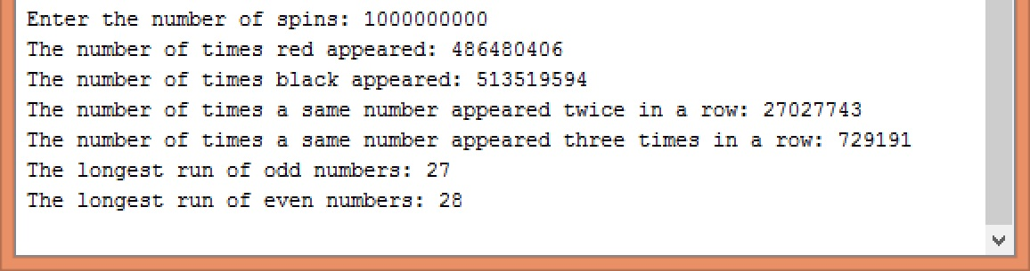
Trial Three (1,000,000,000 Spins)

Slide 5
Theoretical Vs. Actual

Slide 6
Theoretical Vs. Actual

Slide 7
Theoretical Vs. Actual

Slide 8
Are the results in lined with expected outcomes/occurrences?
Yes, you can tell by how closely aligned the bars in the graphs are.

Slide 9
What could be done to further improve our analysis?
We could run each trial multiple times and calculate the average values of the results to compare with the theoretical values.

